Slide 1


My First Web site
Oh! Mydeargreatteacher Coffee and VINYLS
藝伎咖啡
Student:
Teacher:My dear great teacher

Slide 2
agenda
Web programming
Web server and database
HTML programming
CSS
JAVAscript
My funny web site

Slide 3
Web programming

Slide 4
Client-side web programming

Slide 5
Server-side progrmming
https://en.wikipedia.org/wiki/Server-side_scripting
Server-side scripting is a technique used in web development which involves employing scripts on a web server which produces a response customized for each user's (client's) request to the website.
The alternative is for the web server itself to deliver a static web page.
Scripts can be written in any of a number of server-side scripting languages that are available (see below).
Server-side scripting is distinguished from client-side scripting where embedded scripts, such as JavaScript, are run client-side in a web browser, but both techniques are often used together.

Slide 6
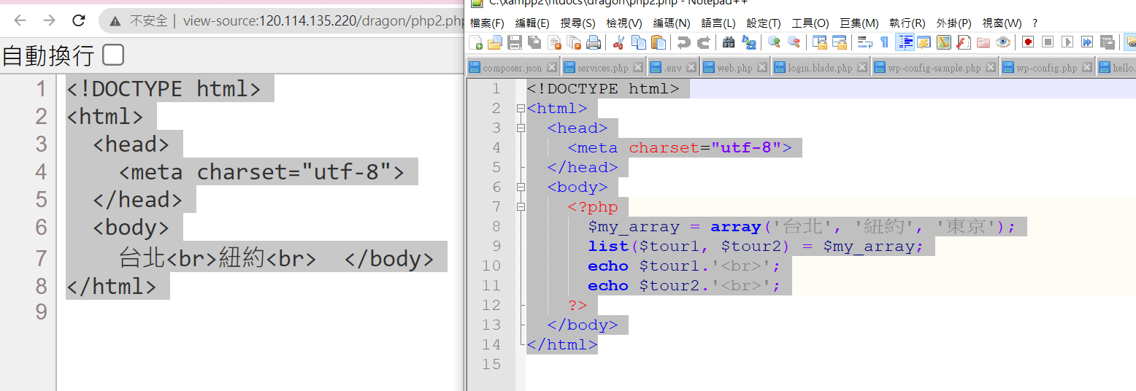
Browser what you see
Original PHP program
Server-side programming

Slide 7
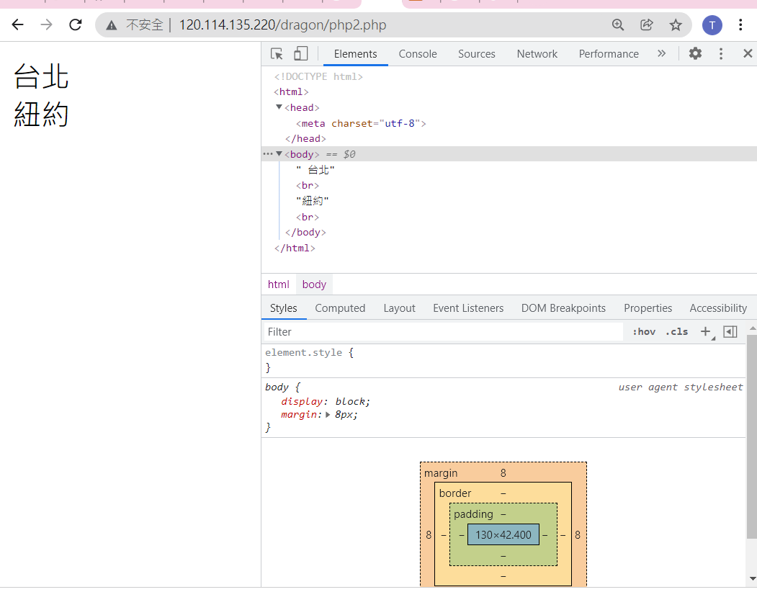

Slide 8
Web server and database
Using XAMPP

Slide 9
xampp

Slide 10
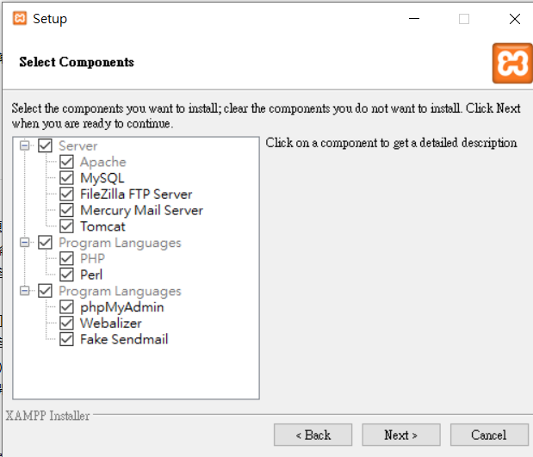

Slide 11
https://en.wikipedia.org/wiki/Webalizer

Slide 12
phpMyAdmin is a free software tool written in PHP
A web interface for MySQL and MariaDB.
https://docs.phpmyadmin.net/,

Slide 13
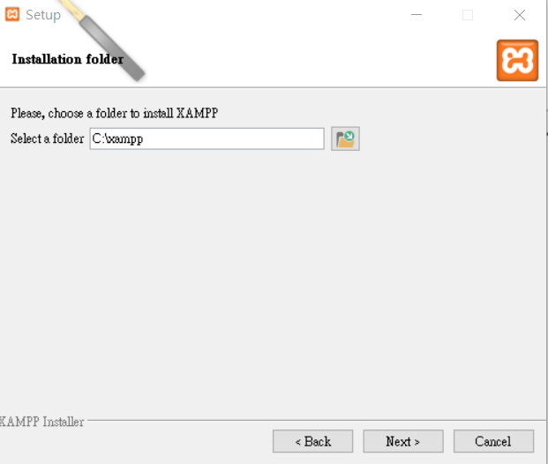

Slide 14
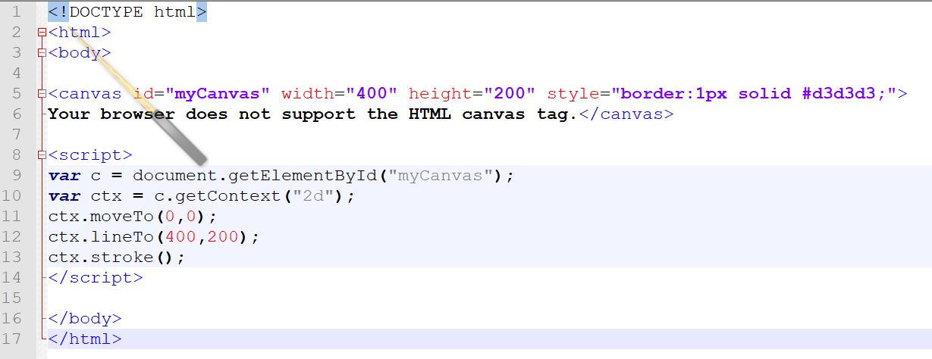
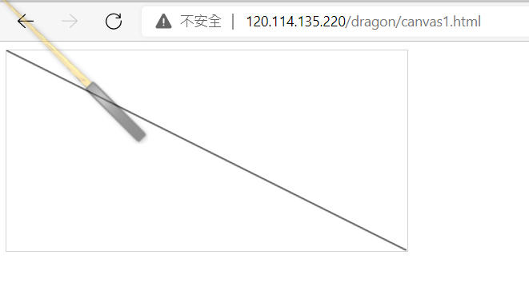

Slide 15
My Web Site
Oh! Mydeargreatteacher
Coffee and VINYLS

Slide 16
index.html

Slide 17
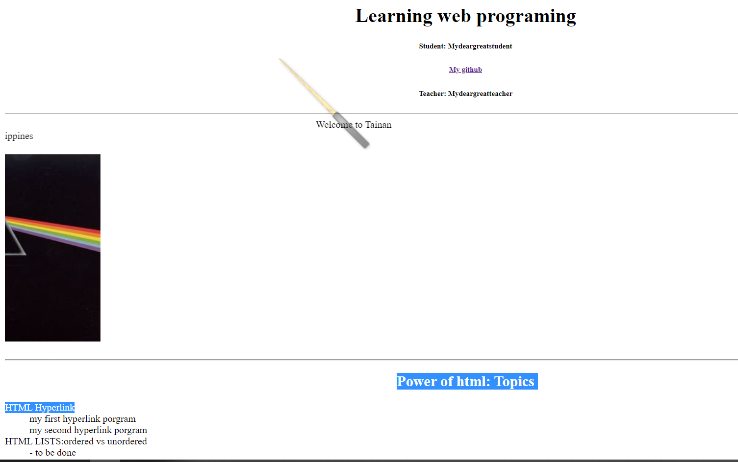
Index.html

Slide 18
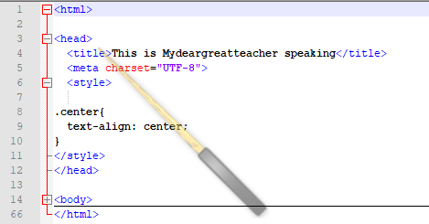

Slide 19
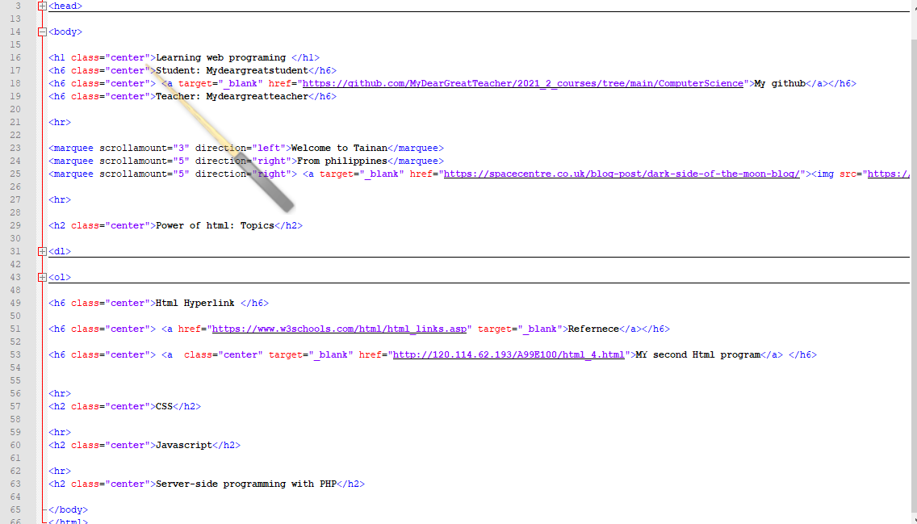
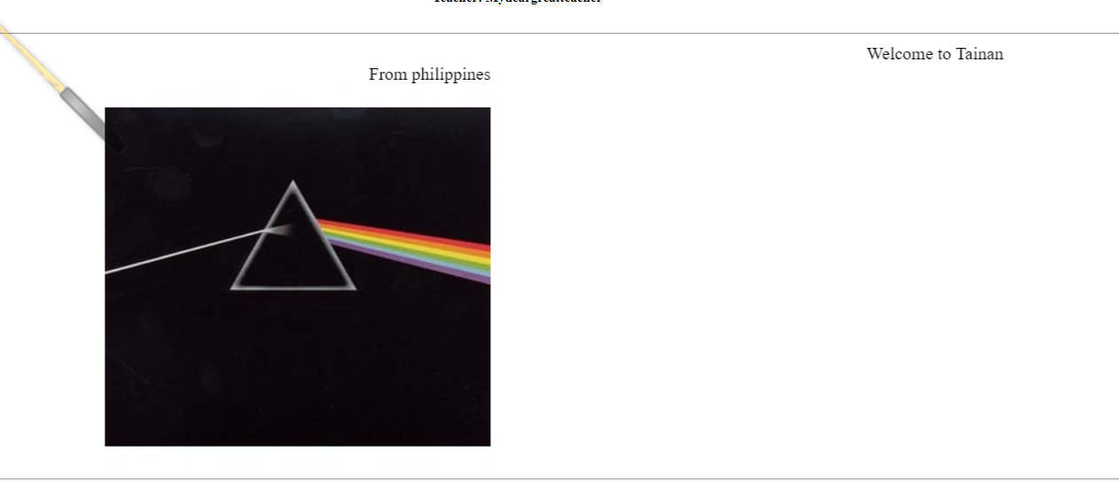
marquee

Slide 20
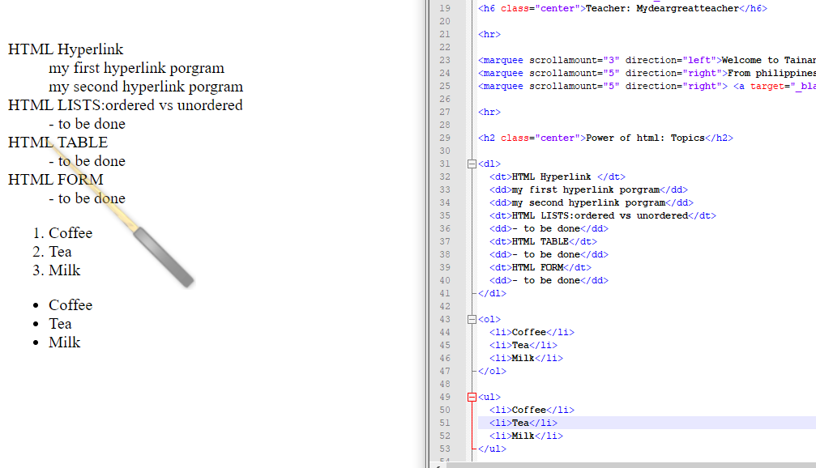
Ordered list

Slide 21
unOrdered list

